Slide 1

MS Power BI Cloud and Report Server
Presented By:
Hazem Hamada
Youssef Dawood

Slide 2
Table of contents
What is Power BI?
What is Power BI Cloud?
What is Power BI Report Server?
PBI Cloud Services.
PBI Report Server Services.
Common components in PBI Cloud and Report Server.
Flow of Data in Power BI.

Slide 3
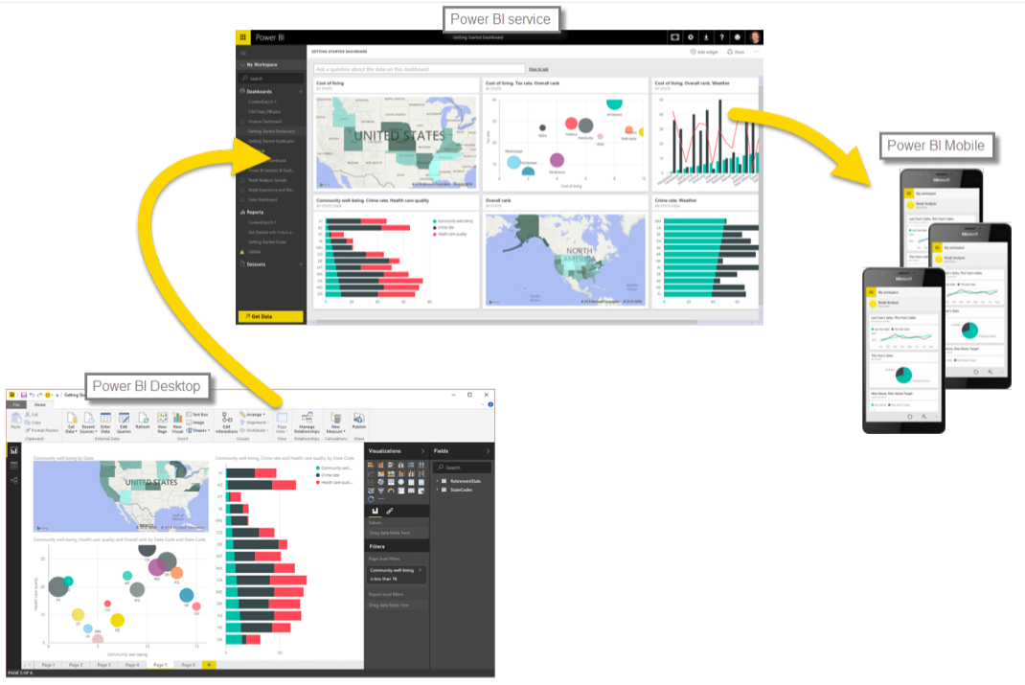
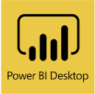
What is Power BI?
Power BI is a suite of Business Analytics tools to analyze data and share insights. Power BI dashboards provide a 360-degree view for business users with their most important metrics in one place, updated in real time, and available on all of their devices.

Slide 4
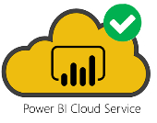
What is Power BI Cloud?
Power BI is a cloud-based business analytics service that gives you a single view of your most critical business data. Monitor the health of your business using a live dashboard, create rich interactive reports with Power BI Desktop and access your. data on the go with native Power BI Mobile apps.

Slide 5
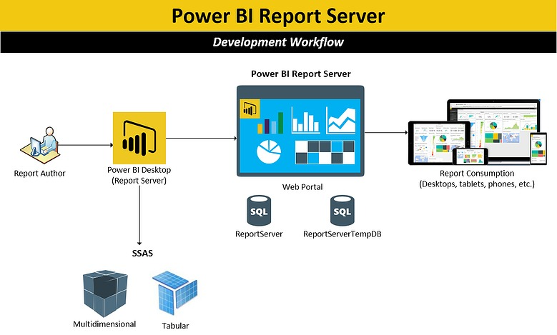
What is Power BI Report Server?
Power BI Report Server is an on-premises report server with a web portal in which you display and manage reports and KPIs. Along with it come the tools to create Power BI reports, paginated reports, mobile reports, and KPIs. Your users can access those reports in different ways: viewing them in a web browser or mobile device, or as an email in their in-box.

Slide 6
Power BI Cloud Services
Release cycle: Every Month
Create Power BI reports in the browser: User can edit reports in the website and rewrite them, or user can save them as a new report. User can also create a new report from an existing or new data source.
Host and connect to power BI shared datasets: power BI allows content creators to publish data sources to the service for the purpose of being single point of truth for report builders who want to reuse these data sets.

Slide 7
Power BI Cloud Services
Dashboards: A Power BI dashboard is a single page, often called a canvas, that uses visualizations to tell a story.
Distribute group of reports using apps: User can create official packaged content, then distribute it to a broad audience as an app, where user can collaborate on Power BI content with his colleagues.
Q&A: The Q&A feature in Power BI lets user explore data in user own words.
Analyze in Excel: This feature allows Power BI users to bring their data sets created on the service to Excel and then view and interact with them using PivotTables, charts, slicers, and other Excel features.

Slide 8
Power BI Cloud Services
Data alerts: Set alerts to notify user when data in his dashboard’s changes beyond limits user set.
Cross-report drill through: With the Power BI cross-report drill-through feature, user can contextually jump from one report to another report in the same Power BI service workspace or app.

Slide 9
Power BI Report Server Services
Release cycle: Every 4 months.
Gateway Not Required
High Security and Confidentiality: As data is stored on server.
High scalability offered with multiple machine instances and load balancer.

Slide 10
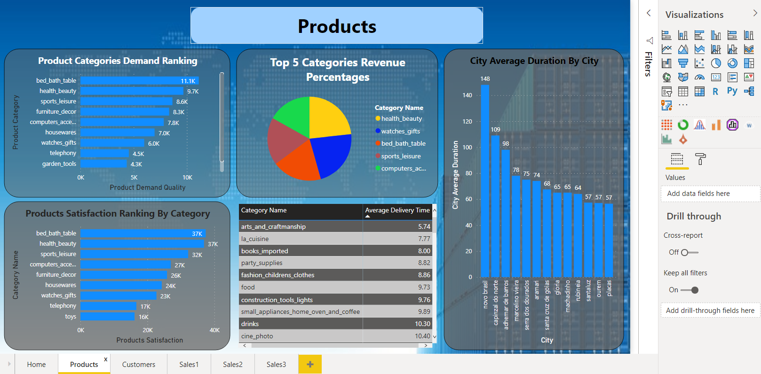
Common components in PBI Cloud and Report Server
Paginated Reports

Slide 11
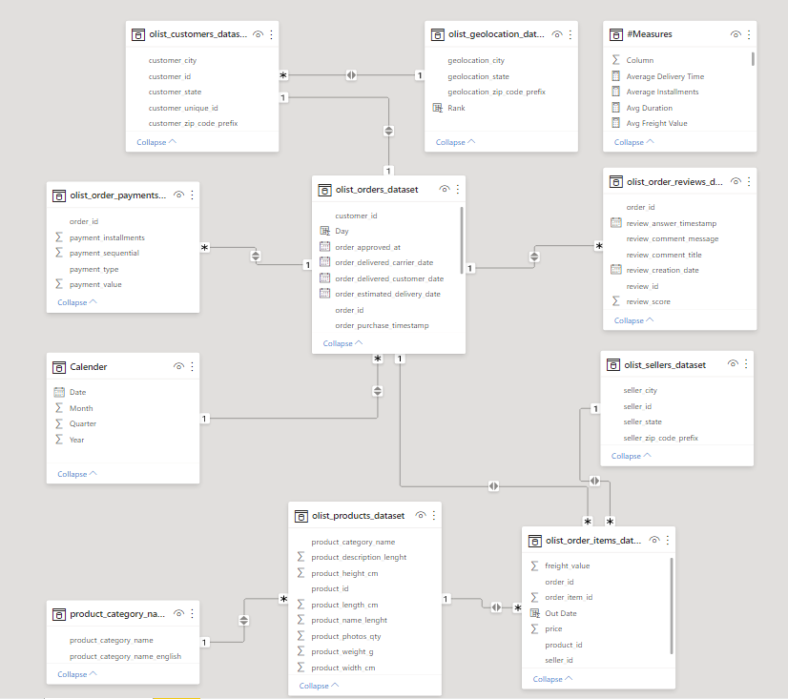
Common components in PBI Cloud and Report Server
Data Modeling: User can edit or create relationships between tables.

Slide 12
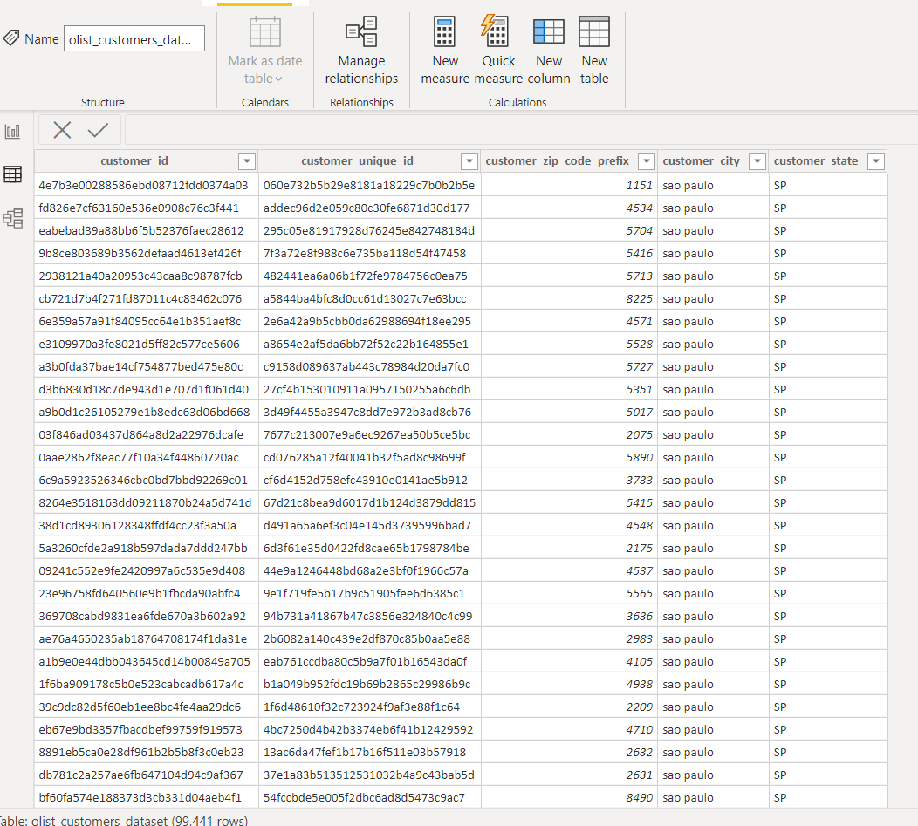
Common components in PBI Cloud and Report Server
Tabular view: User can investigate the data in tables

Slide 13
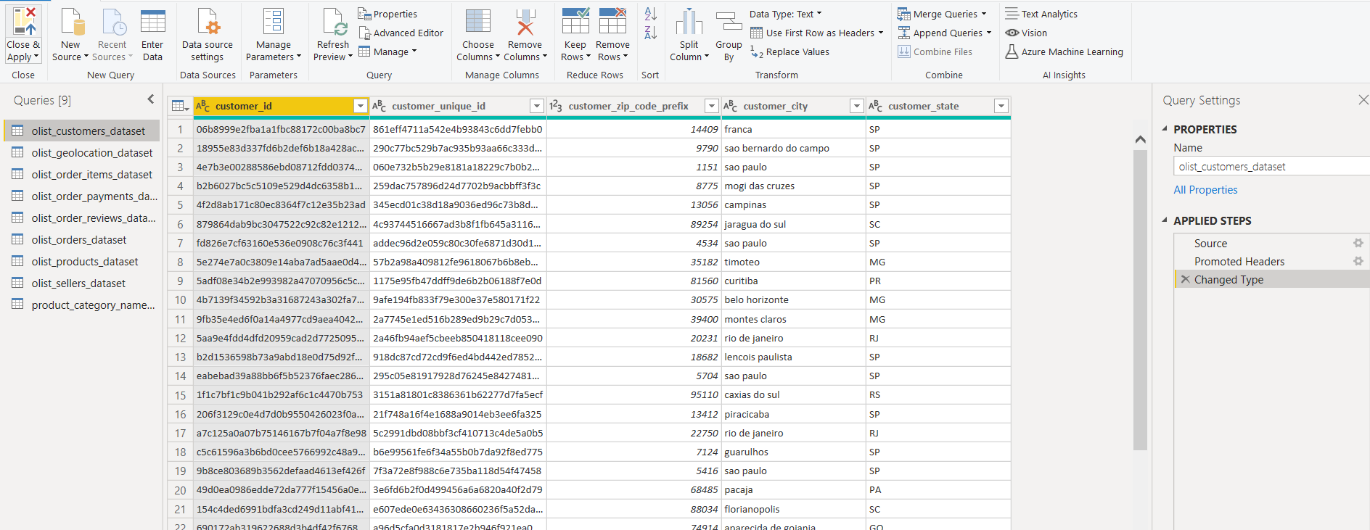
Common components in PBI Cloud and Report Server
Power Query: Apply transformations on data or undo any changes.

Slide 14
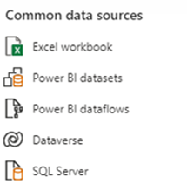
Flow of data in Power BI
1) Extract from multiple sources
2) Transform & Load Data
-Clean errors.
-Change data types
-Rename tables, columns
-M Language.
3) Data Modeling
-One-to-one Rel.
-One-to-Many
-Many-to-Many
-Cross-filter direction
-Ex: Star Schema
4) Visualization
-Support variety of interactive visuals.
-Visualize complex insights using Data Analysis Expression (DAX) language.

Slide 15
Thank You

